Slide 1
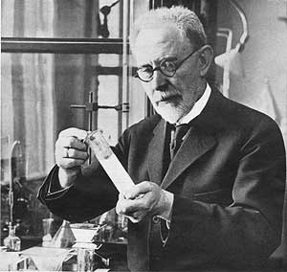
pH Scale
Søren Sørensen
(1868–1939)

Slide 2
Ionization of Water and Kw
1 in every 555 million water molecules will collide and produce H₃O⁺ and OH ⁻ ions
2H₂O (l) ↔ H₃O⁺ (aq) + OH⁻ (aq)
Ionization constant of water (K_{W})
K_{W} = [H3O⁺] [OH ⁻]
- Neutral substances [H3O⁺] = [OH ⁻]
- At pH 7, [H3O⁺] = 1 x 10⁻⁷ M, [OH ⁻] = 1 x 10⁻⁷ M
K_{W}= 1 x 10⁻¹⁴ M

Slide 3
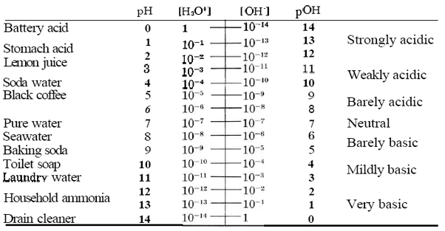
[H₃O⁺] VS. [OH⁻] on pH scale

Slide 4
Animation

Slide 5
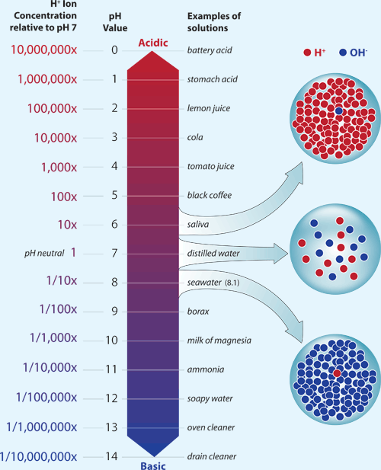
Logarithmic Scale

Slide 6
pH scale
-Hydrogen ion concentration played a key role in enzymatic reactions he devised a simple way of expressing it
-By taking a negative logarithm of hydrogen ion concentration a convenient scale can be established; this is the well-known pH value
-Numerical values based on this unit, now universally in use, give an indication of the acidity of solutions

